Slide 1
DITTY
Decentralized kitty parties (a) chit funds application build on Solana blockchain

Slide 2

| ABOUT DITTY
A Decentralized kitty application built on Solana blockchain is a type of financial application that allows users to create and manage kitty parties in a trustless and secure manner.

Slide 3
| BENEFITS OF DITTY
Transparent & Security
Accountability
Adoption
Establish more user trust
No more daunting to lend money to friend
No compliance or KYC requirements
Lower Costs
Decentralization
Immutable Records
No paperwork, and physical meetings
No central authority for governance
More secure and tamper-proof

Slide 4
| Usecase
Down payment for a house purchase
Small business equipment purchase
Microfinance for farmers

Slide 5
| REVENUE MODEL
1$
FIXED CONTRACT CREATION FEE
1%
ORGANISER MAKES 1% OF LOWEST BID AMOUNT

Slide 6
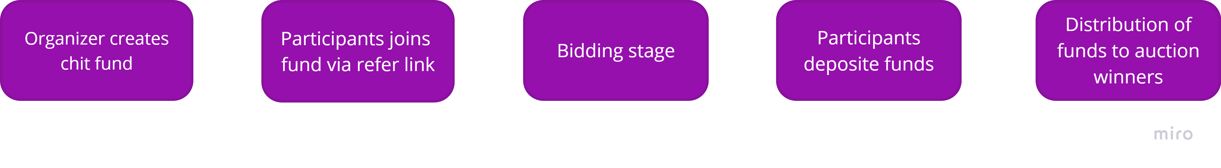
| WORKFLOW

Slide 7
LIVE DEMO

Slide 8



| OUR TEAM
LOKI
ADIT
RK
Backend Smart Contract Developer
Frontend Next.js Developer
Full Stack Developer

Slide 9
| THANKS!
Questions?

